Slide 1
Support Services Volunteer
Information for New Applicants

Slide 2
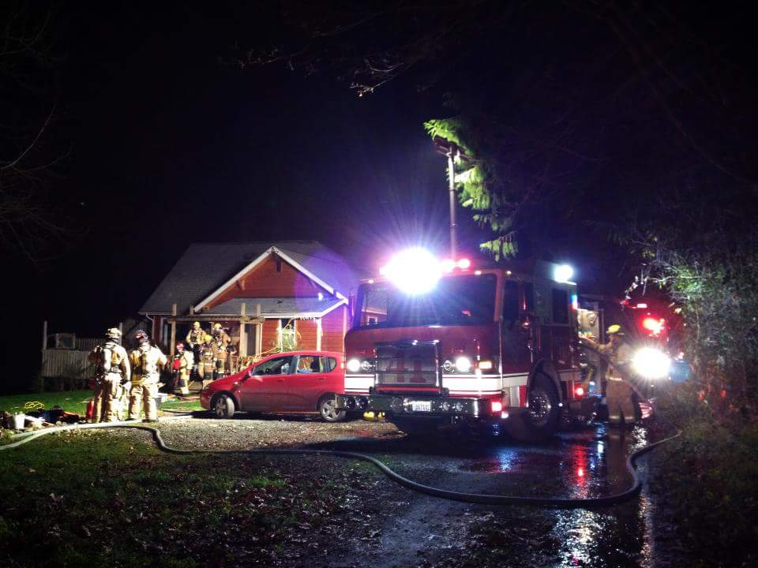
Purpose
Provide an opportunity for citizens interested in volunteering with CKFR for support services to get a better understanding of volunteer requirements and functions.

Slide 3
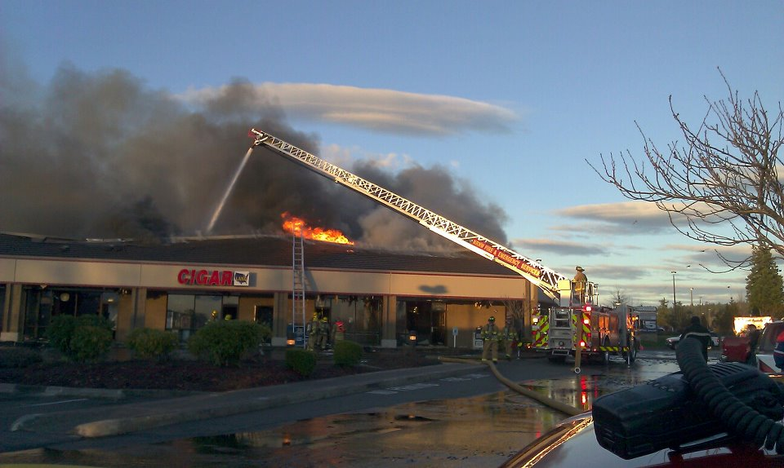
About CKFR
CKFR provides Fire and EMS response to approximately 115 square miles of land and serves a population of more than 75,000 citizens.
The area is experiencing a steady but rapid growth rate.
Beginning 2022, CKFR is building 2 brand new fire stations, is completely replacing 2 additional stations, and has plans to remodel 3 more stations.

Slide 4
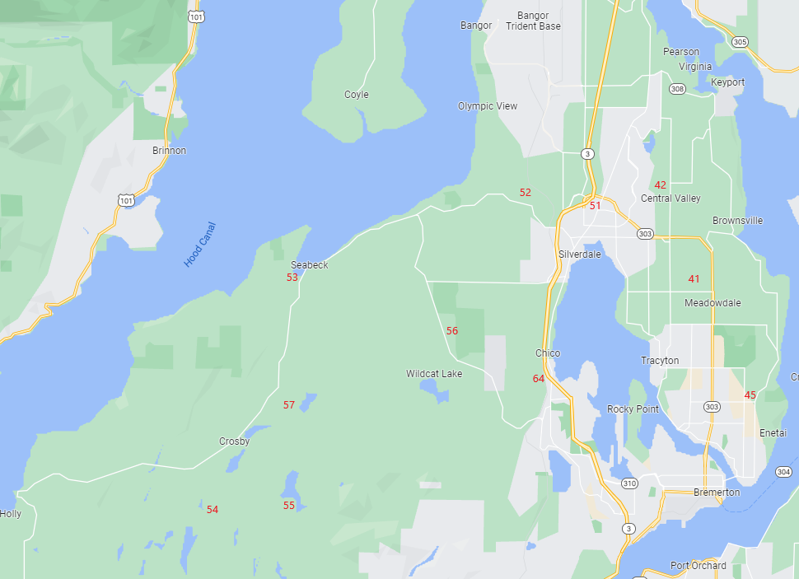
CKFR Fire Stations

Slide 5
Program Changes
There are no new Volunteer Firefighter positions.
As career staffing continues to increase and new stations are built, reducing response times within our community, the 2022 Strategic Plan addressed changing the role of our volunteer program to that of Volunteer Support Services only.

Slide 6
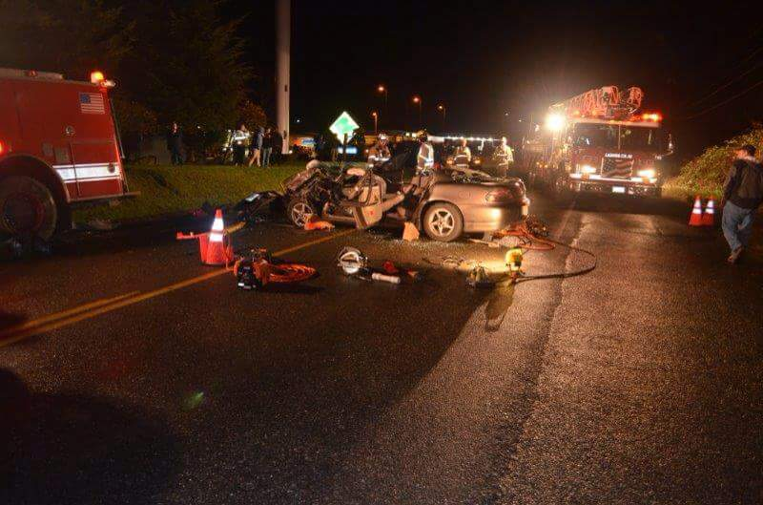
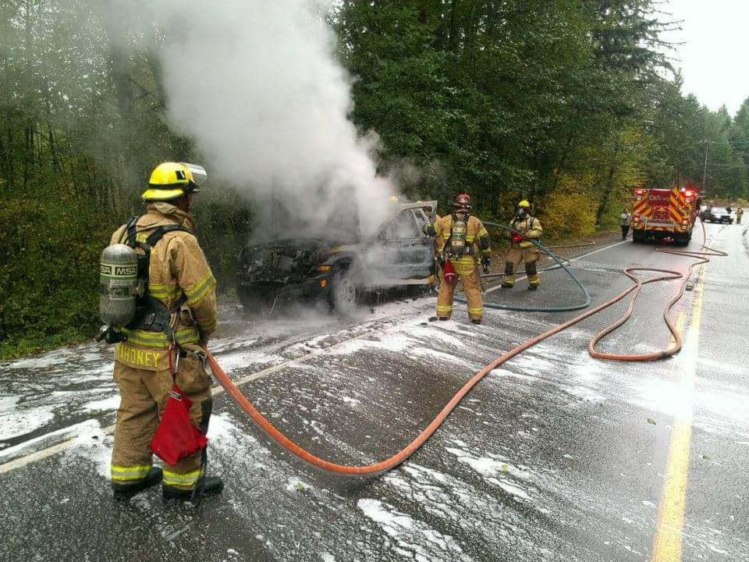
Eligibility
Minimum age of 21 and possess a high school diploma, or equivalent.
Must possess a WA State drivers license.
Pass a Volunteer Physical (CDL Standard).

Slide 7
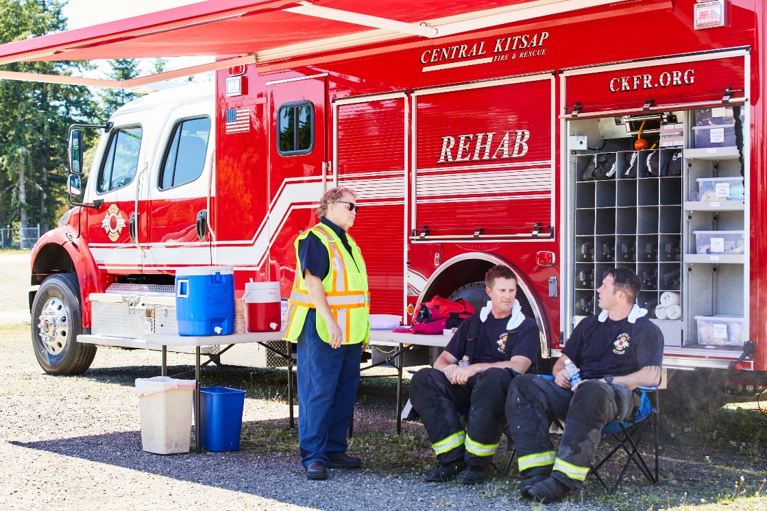
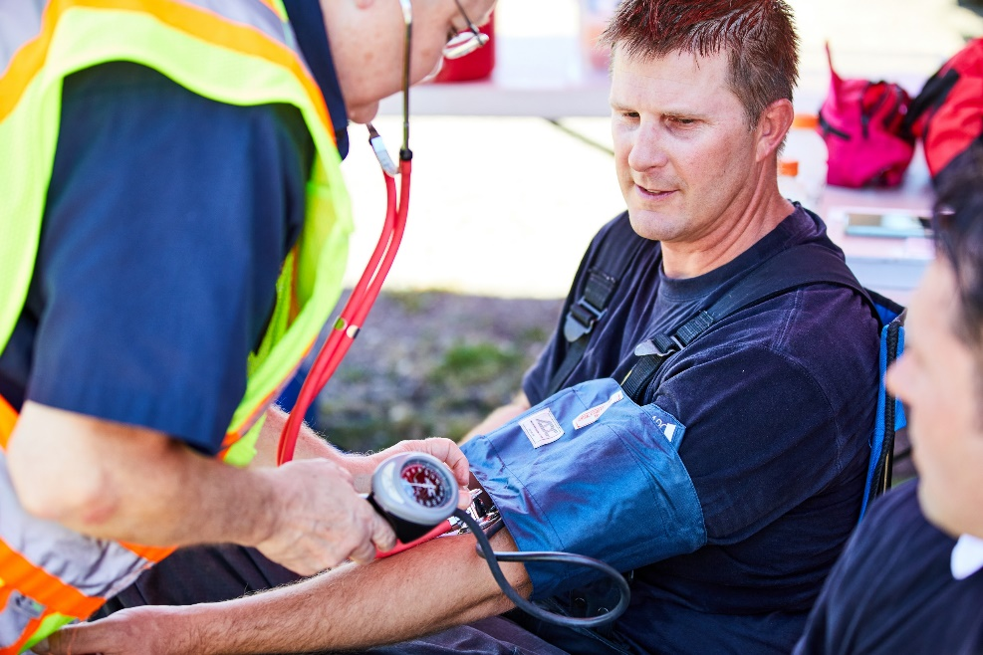
Initial Volunteer Position
All new members will be assigned to Station 42 on Rehab 41.
Rehab provides recuperation and care services to emergency responders on extended emergency scenes.
Initial qualification is as Rehab Operator
Advanced qualification is as a Rehab Driver/Operator

Slide 8
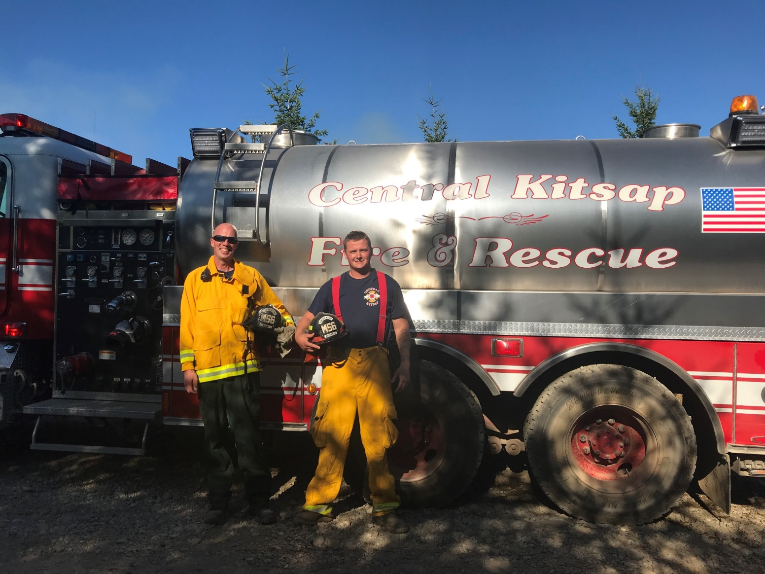
Additional Opportunities
Once a member is fully qualified on Rehab 41, if they are interested, may continue their qualifications on to Driving/Operating a Water Tender (Tender Operator)
Involves completing a hydraulics/pumping course and advanced driver training for heavy vehicle

Slide 9
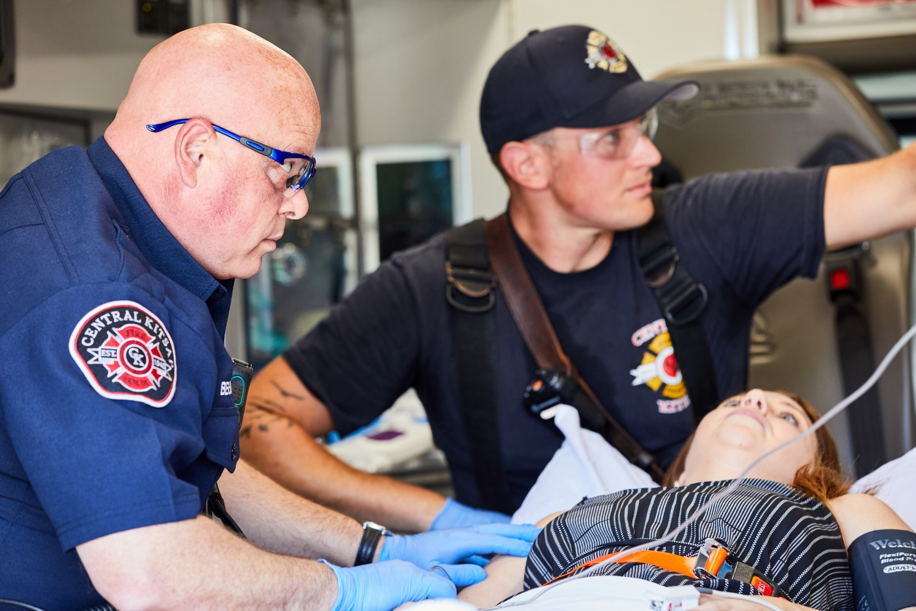
After Your First Year
As a volunteer member in good standing, you may be eligible for additional training as an Emergency Medical Technician (EMT-B)

Slide 10
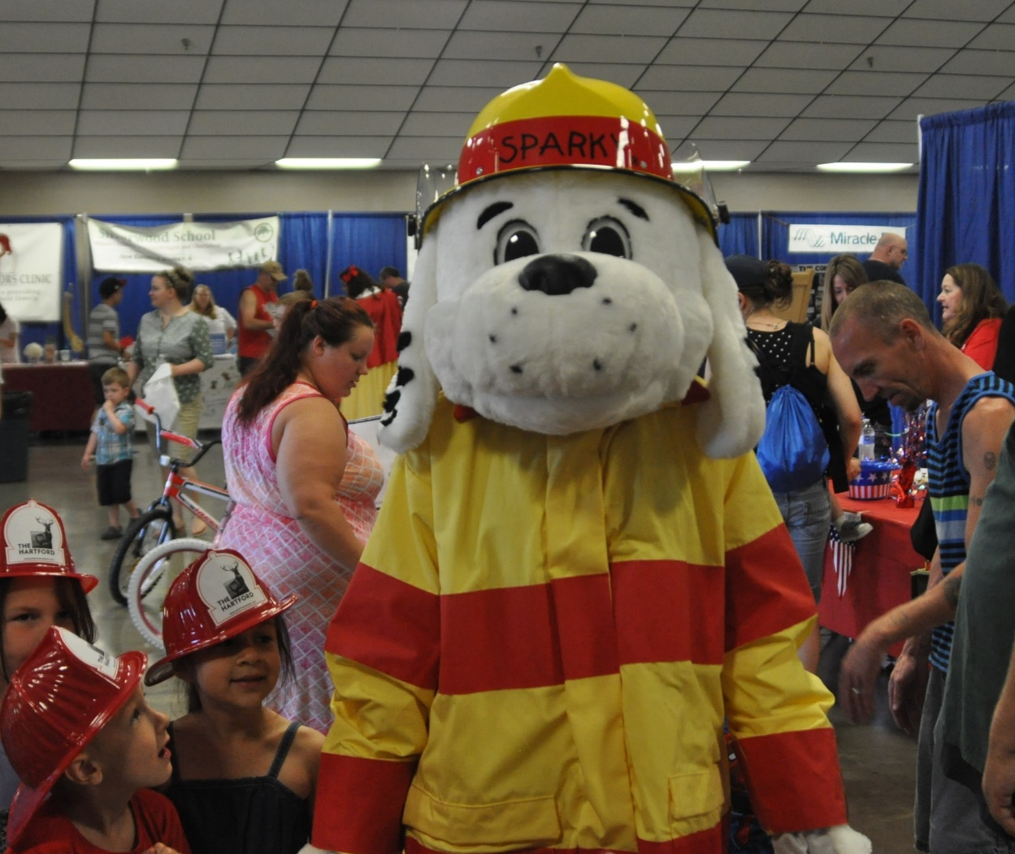
What Will I Really Do?
In order, the two highest priority tasks a volunteer can perform that will have the largest impact to CKFR and the Central Kitsap community are:
Emergency Call Response with Rehab 41
Attend Community Events

Slide 11
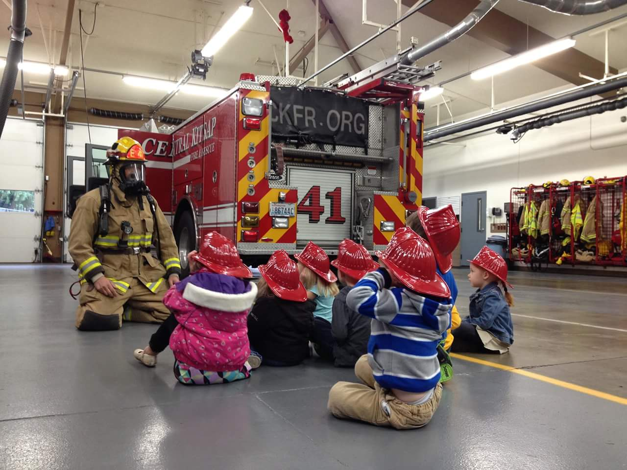
What’s Next?
Apply
Interview
Notifications
Physical Examination & Checks
Orientation & Assignment

